Slide 1
Heritage HorseS
“Toby Time”

Slide 2
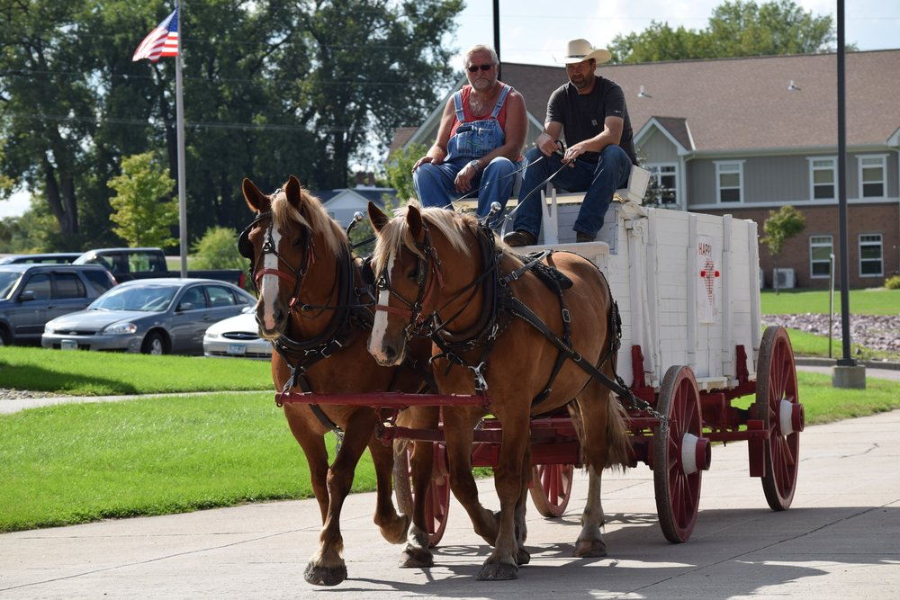
The Beginning
Craigslist “Raindrop”
Community & Holiday events
90th surprise with Draft horses
LTC and me
Mission – bring joy
Notes:
Specifics here from the overview Deb did : Harvest Fest, Lions Club support, my background and animals—seemed a match – others are doing it just not prevalent Very simple mission– bring joy/help

Slide 3
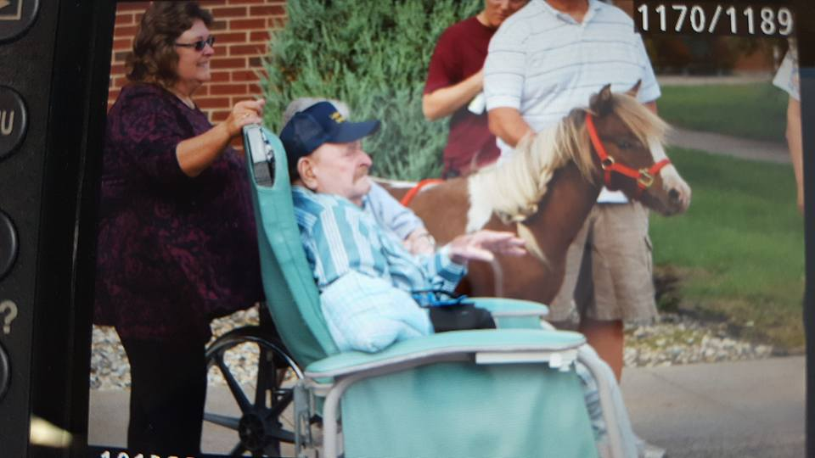
Cactus
Notes:
purpose

Slide 4
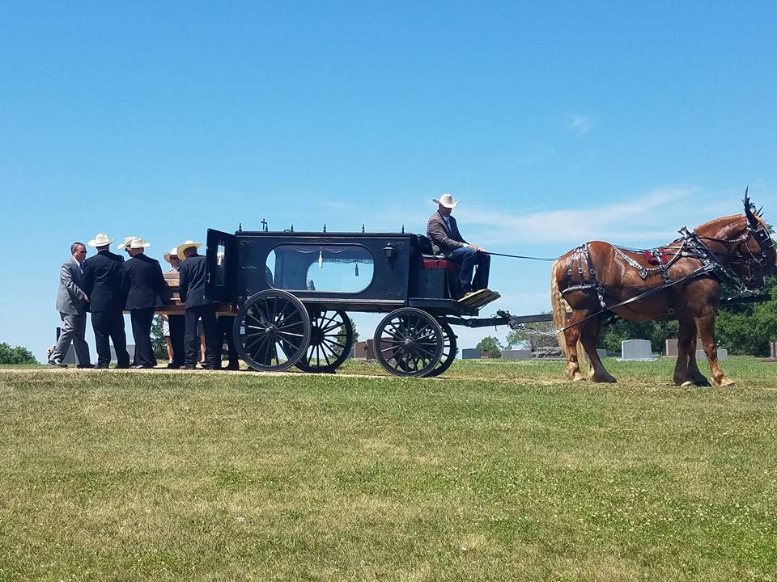
Finding the “why”
“There is no end, There is no beginning , There is only infinite passion for life”

Slide 5
Heritage Horses
We are a small family owned horse service
We love animals, especially horses and we are passionate about sharing them
We provide the horses in the Walnut Grove Pageant for past 16 years

Slide 6
Organizations
Belong to:
The American Miniature Horse Association
The Carriage Operators of American
Quarter Horses Association
Percheron Association
Active in several local shelters and Humane Societies
The Carriage Association of America

Slide 7
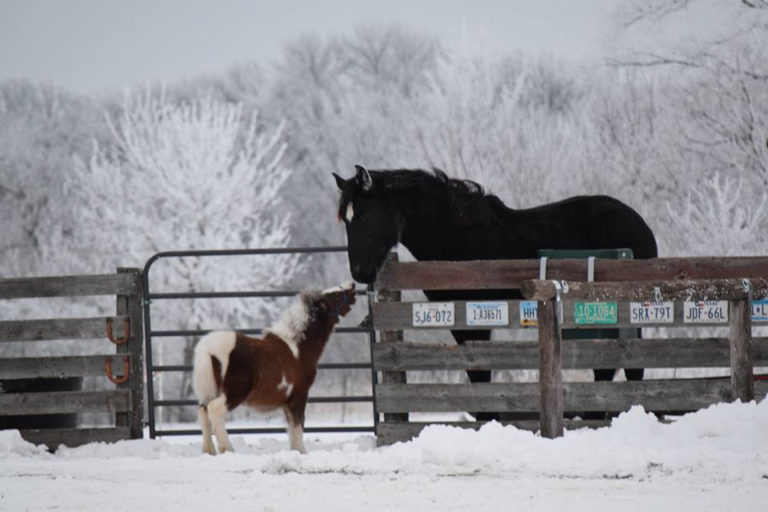
I’M NOT Short. I’m concentrated awesome!

Slide 8
Finding his “talent”
Willing to try new things
Likes everyone

Slide 9
Spreading sunshine
Elderly – LTC focus
Community – parades, holidays, Lions
Kids, Friends and Family
Expand sun beams – new relationships in hospitals or day care or veterans, etc
Runnings outings
Notes:
Benefit, weddings, orchards

Slide 10
Companion, friend, therapy or just a horse of course ☺
Many definitions
“therapy animal” – a partner with a human for comfort and healing to those in need
Several avenues – cape is to clearly identify us is all
A lot of clinical and physiological studies support that companion animals are beneficial
“Unofficial” direction but an important one
End of the day a catalyst for good things and we continue to follow that
Always open to forming policy and adding dialogue

Slide 11
Responsibilities
Toby
To facility or group
Wellness – Healthy
Balanced and Happy
Loved
Confidentiality
Effective Communication
Animal Handling and Best Practices
High Personal Standards
Passion

Slide 12
Building blocks
Partnerships
TODAY! ☺
South Dakota “One Health” Working Group Seminar The Human-Animal Bond in Healthcare Settings
Education with diverse professionals
align with Trade Associations (MN Activities Directors, Leading Age of MN)

Slide 13
Making memories
……………………………………………………………………………………………….

Slide 14
Tough Day

Slide 15
Making Seasons Bright

Slide 16
First day of Spring

Slide 17
Fan club – Greeting with a picture

Slide 18
Hospice Resident and Aha moments

Slide 19
Beside visits

Slide 20
Kiddos and Special events

Slide 21
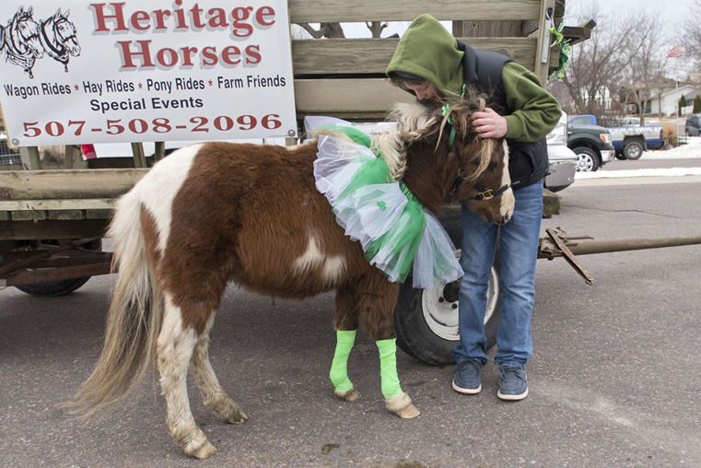
Friends and Family

Slide 22
Down time

Slide 23
THANK YOU
~Shirlene & Toby

